Slide 1




Seed App
Peer-to-peer file sharing system
Each instance acts as both client and server
Multiple file downloads
both client and server
both client and server
Seed App 1
Seed App 2

Slide 2



Supports:
File discovery peers
Seeder validation
Download status monitoring
Chunked downloads

Slide 3




THREADING MODEL
Main
thread
Server
Thread
Tick
Thread
Worker
Thread

Slide 4
THREADING MODEL
Handles the user interface and menu loop.
Main
thread
Notes:
Behavior:
Displays options (Download, Status, Exit).
Reads user input.
Coordinates actions like starting downloads or showing status.

Slide 5
THREADING MODEL
Accepts incoming peer connections.
Server
Thread
Notes:
Behavior:
Runs Host::accept_clients() in a loop.
For each incoming connection, spawns a ClientThread (accept multiple requests from the client) and PeerThread (to connect to other seed apps)
Handles requests like file listing or chunk serving.

Slide 6
THREADING MODEL
Periodically refreshes download jobs.
Tick
Thread
Notes:
3. Tick Thread
Role: Periodically refreshes download jobs.
Behavior:
Specifically, it Refreshes seeders, checks stalled jobs, and updates status every 2 seconds.

Slide 7
THREADING MODEL
Perform actual chunk downloads
Worker
Thread
Notes:
This workers will claim chunks in the file which are available, reads that and writes into a file mark for completion

Slide 8













SERVER VS CLIENT SOCKET MODEL
9001
9000
client
socket
9002
server
socket
client
socket
9003
client
socket
client
socket
One server listening socket per port
Multiple client sockets (one per connection), each handled in its own thread.
9004
Notes:
Each seed app instance reserves one port (9000–9004)
On that port:
It creates one listening socket (used only for accept() calls) from other seed app.
When other seed app connects:
accept() returns a new client socket
A new thread is spawned to handle that client socket.
Outgoing connections
creates client sockets to connect to other peers’ server ports.
Each client socket is independent of the listening socket.

Slide 9


PEER & PORT DISCOVERY
Port Manager scans a fixed range (9000–9004).
First free port → reserved for the server socket.
To discover peers:
The app attempts to connect to other ports in the range.
If connection succeeds,
9001
9000
9001
9002
9003
9004

Slide 10
PEER & PORT DISCOVERY
Port Manager scans a fixed range (9000–9004).
First free port → reserved for the server socket.
To discover peers:
The app attempts to connect to other ports in the range.
If connection succeeds,
9001
9000
9001
9002
9003
9004

Slide 11
PEER & PORT DISCOVERY
Port Manager scans a fixed range (9000–9004).
First free port → reserved for the server socket.
To discover peers:
The app attempts to connect to other ports in the range.
If connection succeeds,
9001
9000
9001
9002
9003
9004

Slide 12
PEER & PORT DISCOVERY
Port Manager scans a fixed range (9000–9004).
First free port → reserved for the server socket.
To discover peers:
The app attempts to connect to other ports in the range.
If connection succeeds,
9001
9000
9001
9002
9003
9004
Notes:
Port Manager scans a fixed range (9000–9004).
First free port → reserved for the server socket. This will be the port of the app.
Now, To discover peers:
The app attempts to connect to other ports in the range. What seed apps are currently up or open right now?
If connection succeeds,

Slide 13
PEER & PORT DISCOVERY
Port Manager scans a fixed range (9000–9004).
First free port → reserved for the server socket.
To discover peers:
The app attempts to connect to other ports in the range.
If connection succeeds,
9001
9000
9001
9002
9003
9004
Notes:
Upon searching, it discovers that Seed App 9001 is now up.

Slide 14
PEER & PORT DISCOVERY
Port Manager scans a fixed range (9000–9004).
First free port → reserved for the server socket.
To discover peers:
The app attempts to connect to other ports in the range.
If connection succeeds, it can now request and download files.
9001
9000
9001
9002
9003
9004
Notes:
The connection now succeeds, both of this apps can now request and download files.

Slide 15

MENU OPTIONS
Option 1 - Download File
Option 2 - Download Status
Option 3 - Exit
Notes:
Now, after connecting successfully, the user can down navigate to the menu.

Slide 16
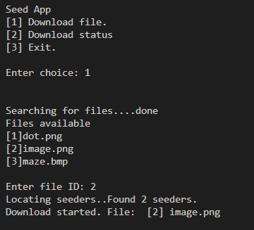
MENU OPTIONS
Option 1 - Download File
Discover files from other peers
Select file by ID
Resolve live seeders
Start download
Notes:
Now, after connecting successfully, the user can down navigate to the menu.

Slide 17
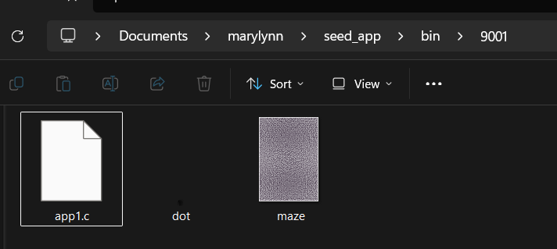
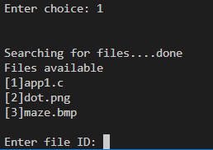
FILE DISCOVERY
Client connects to each peer
User sends choice 1 → list files
Parses filename\t<size> format
Deduplicates by file.key() (name+size)
Sort alphabetically
Builds network_file list

Slide 18
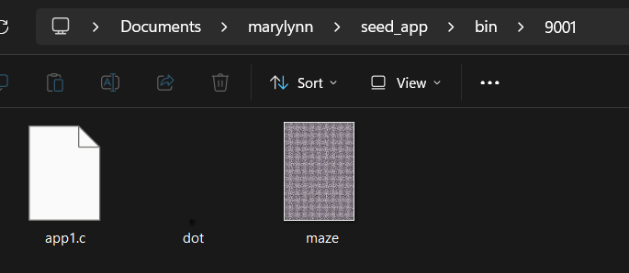
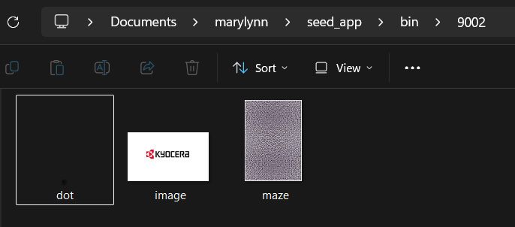
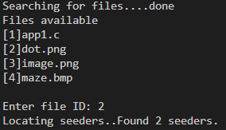
SEEDER RESOLVE
Uses AppSeederResolver
Calls SeederProbe::probe():
Check connected ports
Verifies file presence
Return reachable seeders

Slide 19






DOWNLOADS
DOWNLOAD MANAGER
Download Manager spawns one worker thread per seeder.
Each worker independently:
Claims chunks
Fetches them
Writes them
When all chunks are done:
Last remaining worker renames .part → final file
Job marked Completed
WORKER THREAD (SEEDER A)
WORKER THREAD (SEEDER B)
WORKER THREAD (SEEDER
9001)
WORKER THREAD (SEEDER
9002)
WORKER THREAD (SEEDER
9003)
WORKER THREAD (SEEDER A)
claim_chunk → download → write → mark done
claim_chunk → download → write → mark done

Slide 20
DOWNLOADING MODEL
File split into chunks (default 32 bytes).
Each worker thread:
Connects to a seeder via client socket repeatedly.
Calls claim_chunk_static(job):
Iterates over all chunks.
Atomically marks the first available chunk (state = 0 → 1).
Returns that chunk index.
Requests chunks (Downloader::fetch_chunk_on_connection).
Downloads the chunk from its seeder.
Writes them into .part file.
Marks chunk as completed (state = 2).
9001
9002
WORKER THREAD (SEEDER
9001)
WORKER THREAD (SEEDER
9002)
WORKER THREAD (SEEDER
9003)

Slide 21

WORKERS MODEL
(Work‑stealing / atomic claim scheduler)
Workers race to claim the next available chunk.
The first thread that successfully flips a chunk’s state gets it.
Multiple workers can download different chunks simultaneously.
Any worker can claim any free chunk, no strict ordering.
If a worker fails, its chunk is reset to 0 (unclaimed) so another worker can retry.
Dynamic load balancing: Faster seeders naturally complete more chunks because they claim more often.
0
0
0
WORKER THREAD (SEEDER
9001)
WORKER THREAD (SEEDER
9002)
WORKER THREAD (SEEDER
9003)

Slide 22

WORKERS MODEL
(Work‑stealing / atomic claim scheduler)
Workers race to claim the next available chunk.
The first thread that successfully flips a chunk’s state gets it.
Multiple workers can download different chunks simultaneously.
Any worker can claim any free chunk, no strict ordering.
If a worker fails, its chunk is reset to 0 (unclaimed) so another worker can retry.
Dynamic load balancing: Faster seeders naturally complete more chunks because they claim more often.
0
0
1
WORKER THREAD (SEEDER
9003)
WORKER THREAD (SEEDER
9001)
WORKER THREAD (SEEDER
9002)

Slide 23
WORKERS MODEL
(Work‑stealing / atomic claim scheduler)
Workers race to claim the next available chunk.
The first thread that successfully flips a chunk’s state gets it.
Multiple workers can download different chunks simultaneously.
Any worker can claim any free chunk, no strict ordering.
If a worker fails, its chunk is reset to 0 (unclaimed) so another worker can retry.
Dynamic load balancing: Faster seeders naturally complete more chunks because they claim more often.
2
2
2
WORKER THREAD (SEEDER
9001)
WORKER THREAD (SEEDER
9002)
WORKER THREAD (SEEDER
9003)

Slide 24
How to make sure that while downloading we are connected to other seed apps that have just connected recently?

Slide 25
TICK THREAD LOGIC
Runs every 2 seconds
Refreshes stalled downloads
Uses resolver (seeder probe) to find new seeders
Spawns new workers if needed especially for cases of those disconnected seeders while downloading

Slide 26
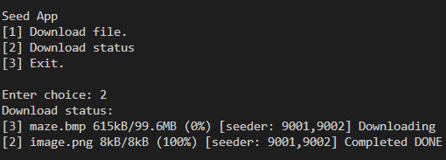
MENU OPTIONS
Option 2 - Download Status
Show progress
Refresh every seconds
Exit on key press
Notes:
Now, after connecting successfully, the user can down navigate to the menu.

Slide 27
DOWNLOAD COMPLETION
Workers exit when done
Final worker renames .part → final file
Updates status:
Idle
Downloading
Completed
Failed
Stalled

Slide 28
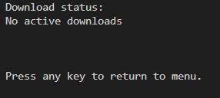
DOWNLOAD STATUS
IDLE
No active download is happening.
Either waiting for a job to start or no jobs exist.
Rarely used in your flow since jobs usually start directly as Downloading.

Slide 29
DOWNLOAD STATUS
Downloading
Active worker threads are fetching chunks from seeders.
Chunks are being claimed, downloaded, and written into the .part file.
This is the “normal running” state.

Slide 30
DOWNLOAD STATUS
Completed
All chunks have been successfully downloaded.
The .part file is renamed to the final file.
Job marked as finished, no more worker threads running.

Slide 31
DOWNLOAD STATUS
Stalled
Download progress has stopped (no seeders available, workers exited without completing).
Not failed yet — system will try to recover by refreshing seeders in the tick thread.
Acts as a “pause” state until new seeders are found.

Slide 32
DOWNLOAD STATUS
Stalled
Download progress has stopped (no seeders available, workers exited without completing).
Not failed yet — system will try to recover by refreshing seeders in the tick thread.
Acts as a “pause” state until new seeders are found.

Slide 33
DOWNLOAD STATUS
Failed
The source file on the seeder was deleted or moved.
The output file cannot be created or written to (disk full, permission denied).
Protocol violation (wrong chunk size, invalid offset).

Slide 34
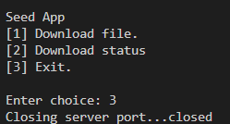
MENU OPTIONS
Option 3 - Exit
Stop server
Join threads
Release port
Notes:
Now, after connecting successfully, the user can down navigate to the menu.

Slide 35
CLASS DIAGRAM

Slide 36
SEQUENCE DIAGRAM
Notes:
When all chunks are done, the .part file is renamed to the final filename. The job state becomes Completed. WorkerExitGuard in worker_run() handles the final rename and marks the job completed. “At any time, the user can check download status. The manager prints progress, seeder ports, and state.” download_manager::get_status_string() builds the status line.
37

Slide 37
DEMO
Notes:
When all chunks are done, the .part file is renamed to the final filename. The job state becomes Completed. WorkerExitGuard in worker_run() handles the final rename and marks the job completed. “At any time, the user can check download status. The manager prints progress, seeder ports, and state.” download_manager::get_status_string() builds the status line.
37

Slide 38
Seed App
APP STARTS
PORT RESERVED
HOST SERVER RUNS
CLIENT CONNECTS
FILES DISCOVERED
SEEDERS RESOLVED
DOWNLOAD JOB CREATED
WORKERS FETCH CHUNKS
ERRORS HANDLED
FILE COMPLETED.
both client and server
both client and server
Seed App 1
Seed App 2
Notes:
When all chunks are done, the .part file is renamed to the final filename. The job state becomes Completed. WorkerExitGuard in worker_run() handles the final rename and marks the job completed. “At any time, the user can check download status. The manager prints progress, seeder ports, and state.” download_manager::get_status_string() builds the status line.
37

